Slide 1

Bayesian Models in Machine Learning
Lukáš Burget
Escuela de Ciencias Informáticas 2017
Buenos Aires, July 24-29 2017

Slide 2
Frequentist vs. Bayesian
Frequentist point of view:
  Probability is the frequency of an event occurring in a large (infinite) number of trials
  E.g. When flipping a coin many times, what is the proportion of heads?
Bayesian
  Inferring probabilities for events that have never occurred or believes which are not directly observed
  Prior believes are specified in terms of prior probabilities
  Taking into account uncertainty (posterior distribution) of the estimated parameters or hidden variables in our probabilistic model.

Slide 3


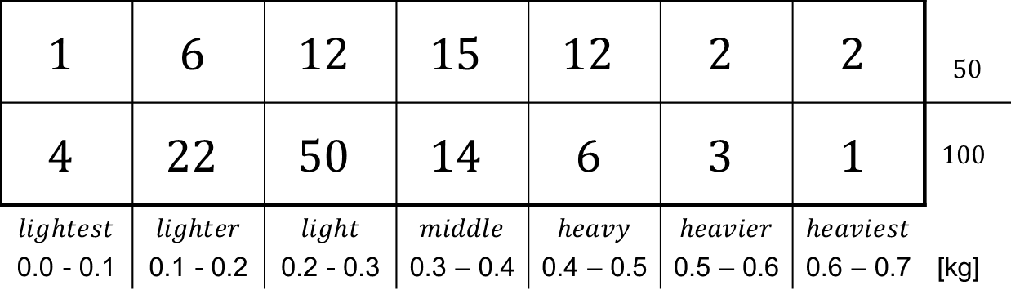
Simple classification problem – I.
Simple example of learning a probabilistic model for maximum
a-posteriori classification
  to introduce classification as a basic problem from machine learning field
  to understand frequentist’s view of “probability” and to show its limitations as compared to the Bayesian approaches
  to refresh basics from probability theory
The task is to classify an object (grenade or apple) given an observation (discrete weight category)
  It is heavy. Is it grenade or apple?
Lets have 150 observations as training data
  Table of observation counts for each class and weight category
$$1$$ | $$6$$ | $$12$$ | $$15$$ | $$12$$ | $$2$$ | $$2$$ | $$50$$
$$4$$ | $$22$$ | $$50$$ | $$14$$ | $$6$$ | $$3$$ | $$1$$ | $$100$$
$$lightest$$ 0.0 - 0.1 | $$lighter$$ 0.1 - 0.2 | $$light$$ 0.2 - 0.3 | $$middle$$ 0.3 – 0.4 | $$heavy$$ 0.4 – 0.5 | $$heavier$$ 0.5 – 0.6 | $$heaviest$$ 0.6 – 0.7 | [kg]

Slide 4
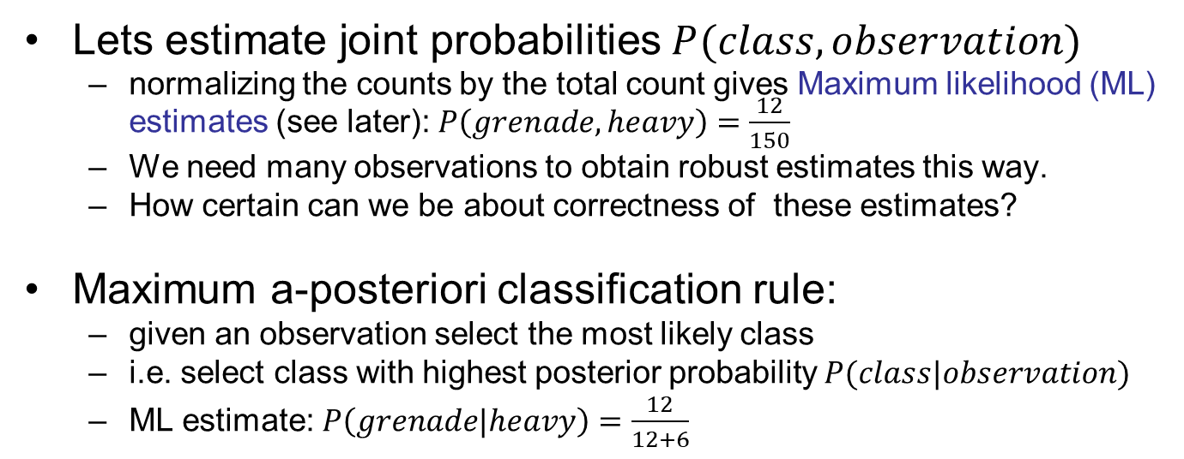
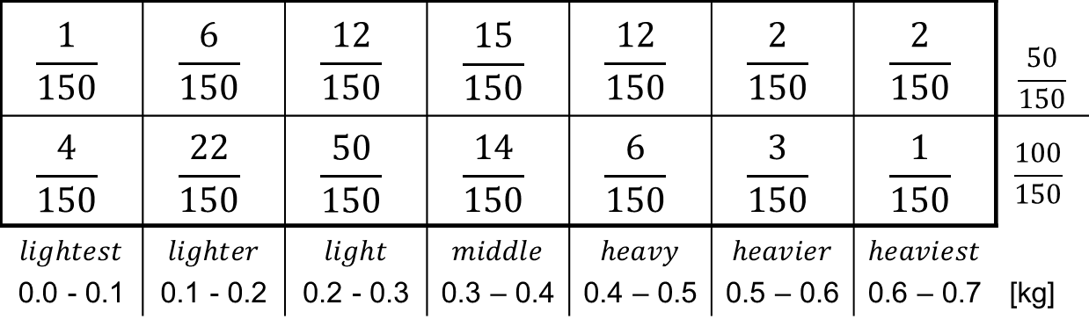
Simple classification problem – II.
Lets estimate joint probabilities $P(class, observation)$
  normalizing the counts by the total count gives Maximum likelihood (ML) estimates (see later): $P\left(grenade, heavy\right)=\frac{12}{150}$
  We need many observations to obtain robust estimates this way.
  How certain can we be about correctness of these estimates?
Maximum a-posteriori classification rule:
  given an observation select the most likely class
  i.e. select class with highest posterior probability $P(class|observation)$
  ML estimate: $P\left(grenade|heavy\right)=\frac{12}{12+6}$
$$\frac{1}{150}$$ | $$\frac{6}{150}$$ | $$\frac{12}{150}$$ | $$\frac{15}{150}$$ | $$\frac{12}{150}$$ | $$\frac{2}{150}$$ | $$\frac{2}{150}$$ | $$\frac{50}{150}$$
$$\frac{4}{150}$$ | $$\frac{22}{150}$$ | $$\frac{50}{150}$$ | $$\frac{14}{150}$$ | $$\frac{6}{150}$$ | $$\frac{3}{150}$$ | $$\frac{1}{150}$$ | $$\frac{100}{150}$$
$$lightest$$ 0.0 - 0.1 | $$lighter$$ 0.1 - 0.2 | $$light$$ 0.2 - 0.3 | $$middle$$ 0.3 – 0.4 | $$heavy$$ 0.4 – 0.5 | $$heavier$$ 0.5 – 0.6 | $$heaviest$$ 0.6 – 0.7 | [kg]

Slide 5
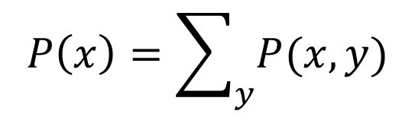

Basic rules of probability theory – I.
Sum rule:
Product rule:
Bayes rule:
$$P\left(x\right)=\sum_{y}{P(x,y)}$$
$$P\left(x,y\right)=P\left(x|y\right)P\left(\text{y}\right)=P\left(y|x\right)P(x)$$
$$P\left(y|x\right)=\frac{P\left(x|y\right)P\left(y\right)}{P(x)}$$

Slide 6
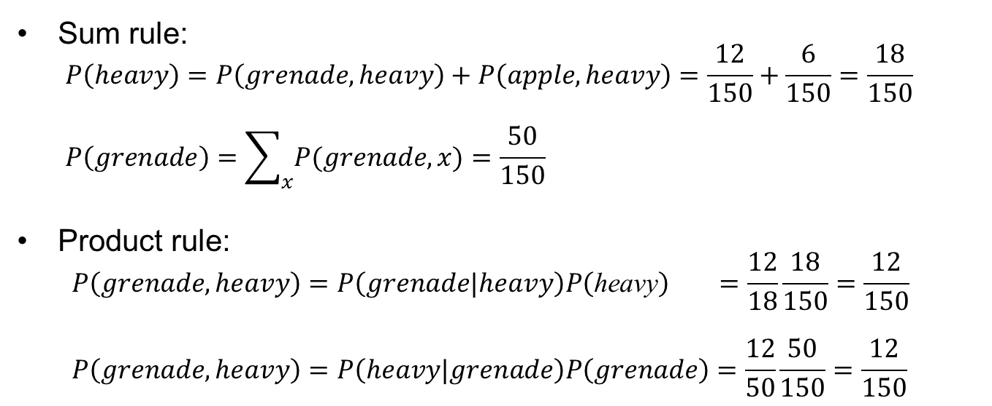
Basic rules of probability theory – II.
Sum rule:
  $$P\left(heavy\right)=P\left(grenade,heavy\right)+P\left(apple,heavy\right)=\frac{12}{150}+\frac{6}{150}=\frac{18}{150}$$
  $$P\left(grenade\right)=\sum_{x}{P(grenade,x)}=\frac{50}{150}$$
Product rule:
  $$P\left(grenade, heavy\right)=P\left(grenade|heavy\right)P\left(\text{heavy}\right) =\frac{12}{18}\frac{18}{150}=\frac{12}{150}$$
  $$P\left(grenade, heavy\right)=P\left(heavy|grenade\right)P\left(grenade\right)=\frac{12}{50}\frac{50}{150}=\frac{12}{150}$$
$$\frac{1}{150}$$ | $$\frac{6}{150}$$ | $$\frac{12}{150}$$ | $$\frac{15}{150}$$ | $$\frac{12}{150}$$ | $$\frac{2}{150}$$ | $$\frac{2}{150}$$ | $$\frac{50}{150}$$
$$\frac{4}{150}$$ | $$\frac{22}{150}$$ | $$\frac{50}{150}$$ | $$\frac{14}{150}$$ | $$\frac{6}{150}$$ | $$\frac{3}{150}$$ | $$\frac{1}{150}$$ | $$\frac{100}{150}$$
$$lightest$$ 0.0 - 0.1 | $$lighter$$ 0.1 - 0.2 | $$light$$ 0.2 - 0.3 | $$middle$$ 0.3 – 0.4 | $$heavy$$ 0.4 – 0.5 | $$heavier$$ 0.5 – 0.6 | $$heaviest$$ 0.6 – 0.7 | [kg]

Slide 7
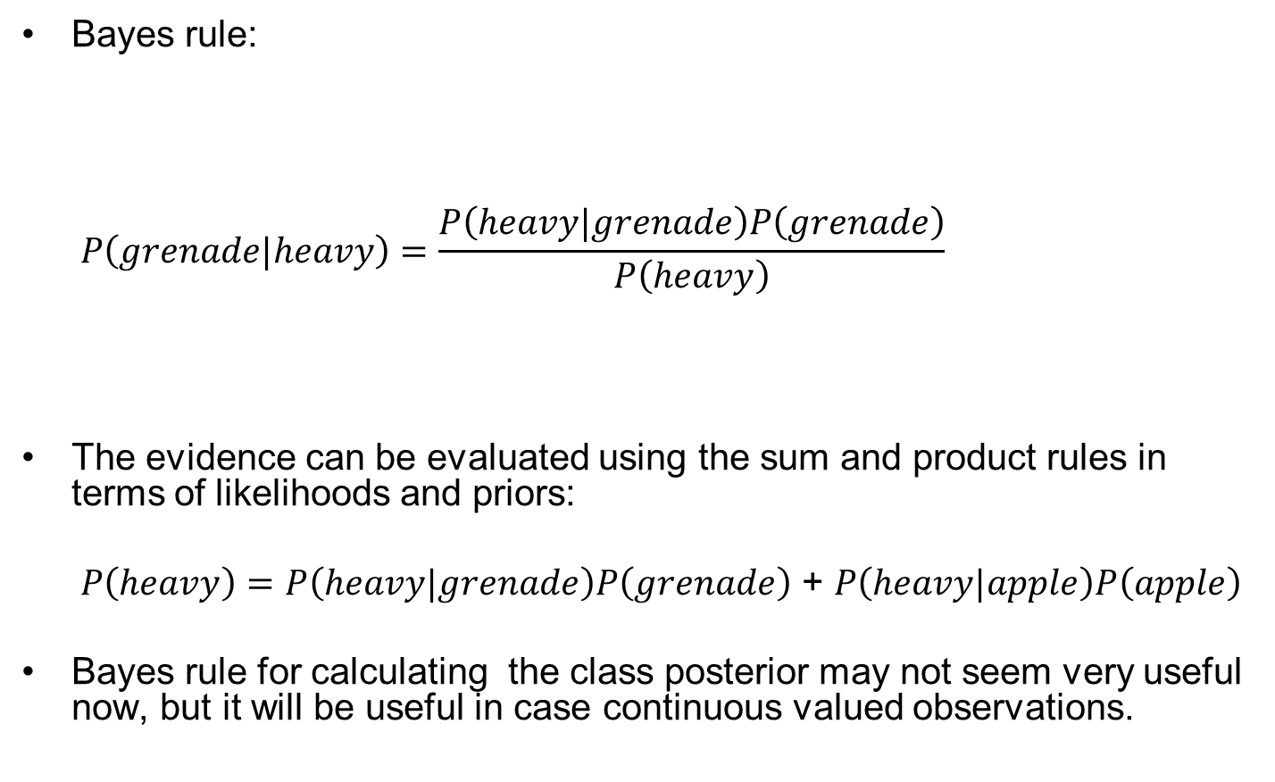
Basic rules of probability theory – III.
Bayes rule:
  $$P\left(grenade|heavy\right)=\frac{P\left(heavy|grenade\right)P\left(grenade\right)}{P\left(heavy\right)}$$
The evidence can be evaluated using the sum and product rules in terms of likelihoods and priors:
  $P\left(heavy\right)=P\left(heavy|grenade\right)P\left(grenade\right)$ + $P\left(heavy|apple\right)P\left(apple\right)$
Bayes rule for calculating the class posterior may not seem very useful now, but it will be useful in case continuous valued observations.
Posterior probability
Likelihood
Prior probability
Evidence

Slide 8
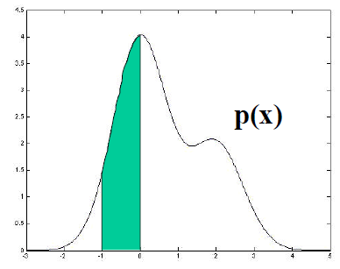

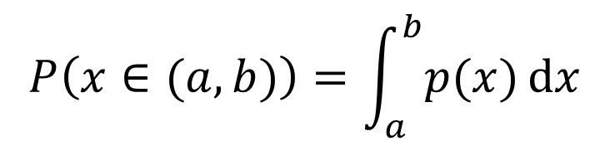
Continuous random variables
P(x) –probability
p(x) –probability density function
Sum rule:
$$P\left(x∈(a,b)\right)=\int_{a}^{b}{p(x)}dx$$
p(x)
→ x
$$p\left(x\right)=\int{p(x,y)}dy$$

Slide 9

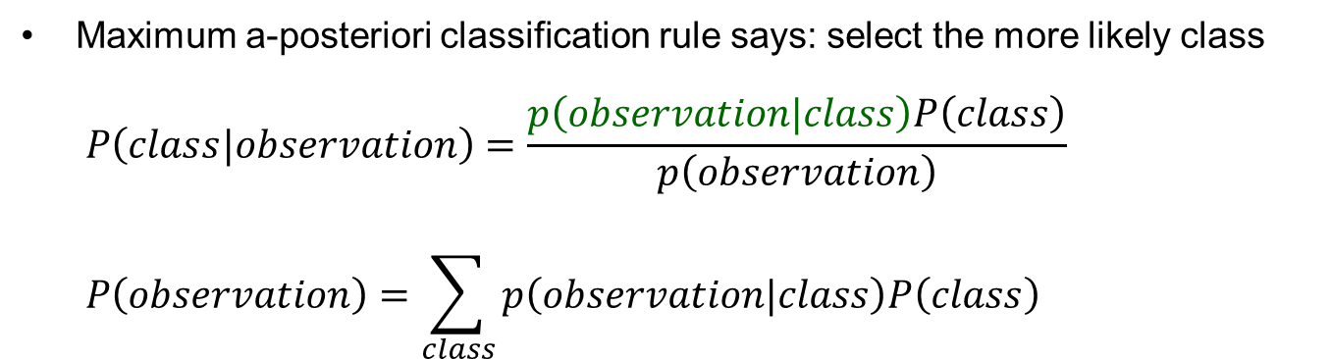

Classification with continuous observations
→ $p(observation|class)$
grenade
apple
→ $observation (e.g. weight)$
Maximum a-posteriori classification rule says: select the more likely class
  $$P\left(class|observation\right)=\frac{p\left(observation|class\right)P\left(class\right)}{p\left(observation\right)}$$
  $$P\left(observation\right)=\sum_{class}{p\left(observation|class\right)P\left(class\right)}$$

Slide 10
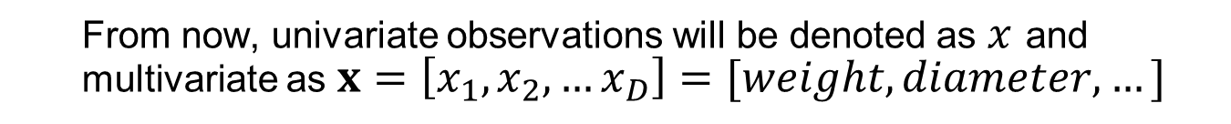

Multivariate observations
  From now, univariate observations will be denoted as $x$ and multivariate as $x=\left[x_{1},x_{2},…x_{D}\right]=[weight, diameter,…]$
→ $p(x|class)$
→x₁
→x₂

Slide 11

Estimation of parameters
Usually we do not know the true distributions $p\left(x | class\right)$
→ $p(x|class)$
→ x

Slide 12

Estimation of parameters
… we only see some training examples.
Let’s decide for some parametric model for $p\left(x | class\right)$
(e.g. Gaussian distribution) and estimate its parameters from the data.
Here, we are using the frequentist approach: Estimated distributions tell us that observation x will be more likely as we see more similar observations in the training data.
From now, lets forget about classes. We will concentrate just on estimating probability density functions (e.g. one for each class).
silence
unvoiced
voiced
→ $p(x|class)$
→ x

Slide 13
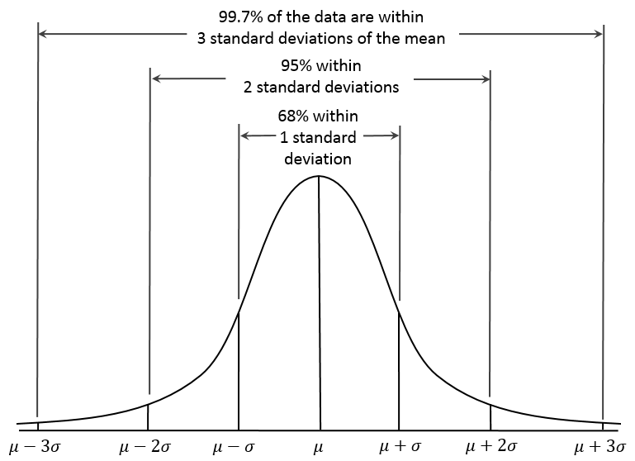
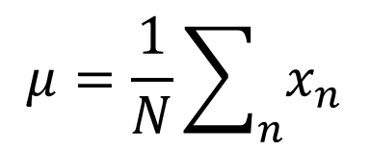
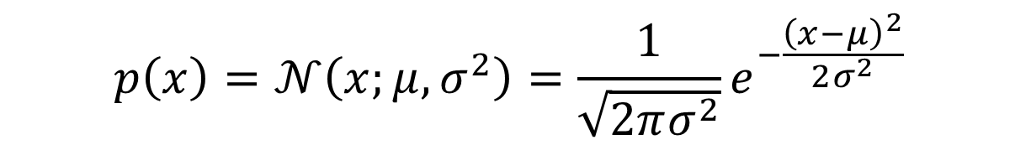
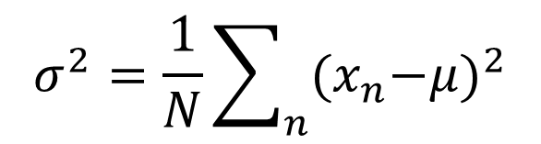
Gaussian distribution (univariate)
$$p\left(x\right)=𝒩\left(x;μ,σ^{2}\right)=\frac{1}{\sqrt{2πσ^{2}}}e^{−\frac{{\left(x−μ\right)}^{2}}{2σ^{2}}}$$
ML estimates of parameters
$$μ=\frac{1}{N}\sum_{n}{x_{n}}$$
$$σ^{2}=\frac{1}{N}\sum_{n}{{{(x}_{n}−μ)}^{2}}$$

Slide 14
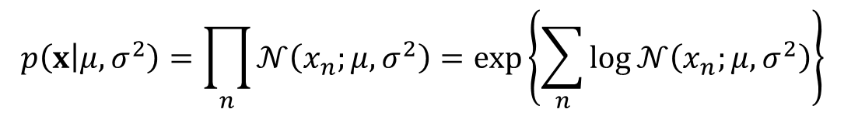
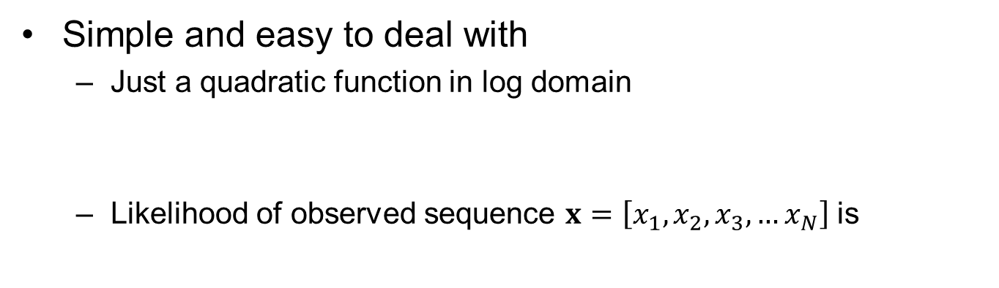
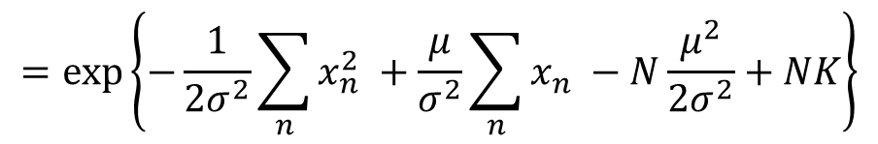
Why Gaussian distribution?
Simple and easy to deal with
  Just a quadratic function in log domain
  Likelihood of observed sequence $x=\left[x_{1}, x_{2},x_{3},…x_{N}\right]$ is
$$log𝒩\left(x;μ,σ^{2}\right)=−\frac{log\left(2πσ^{2}\right)}{2} −\frac{1}{2σ^{2}}{\left(x−μ\right)}^{2}=−\frac{1}{2σ^{2}}x^{2}+\frac{μ}{σ^{2}}x−\frac{μ^{2}}{2σ^{2}}+K$$
$$p\left(x | μ,σ^{2}\right)=\prod_{n}{𝒩\left(x_{n};μ,σ^{2}\right)}=exp\left\{\sum_{n}{log}𝒩\left(x_{n};μ,σ^{2}\right)\right\}$$
$$=exp\left\{−\frac{1}{2σ^{2}}\sum_{n}{x_{n}^{2} }+\frac{μ}{σ^{2}}\sum_{n}{x_{n} }−N\frac{μ^{2}}{2σ^{2}}+NK\right\}$$
Sufficient statistics
(second, first and zero order)

Slide 15
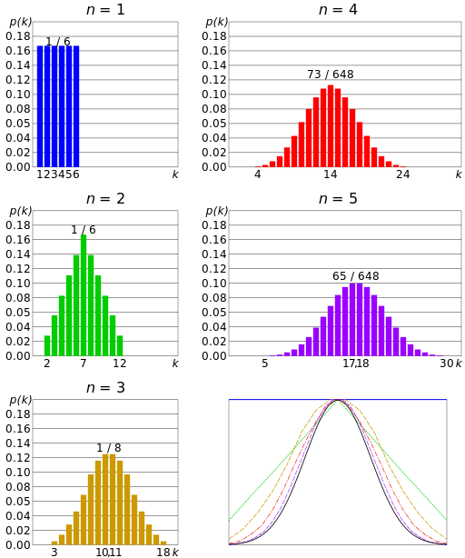
Why Gaussian distribution?
Naturally occurring
Central limit theorem: Summing values of many independently generated random variables gives Gaussian distributed observations
Examples:
  Summing outcome of N dices
  Galton’s board
  https://www.youtube.com/watch?v=03tx4v0i7MA

Slide 16
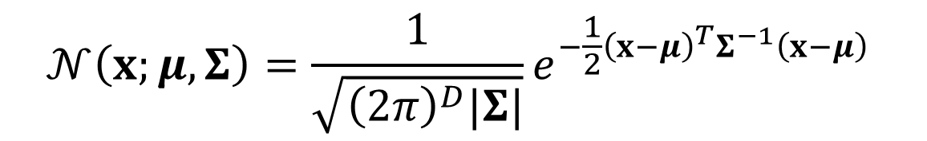

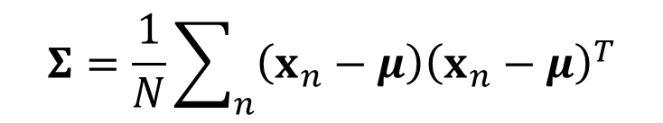
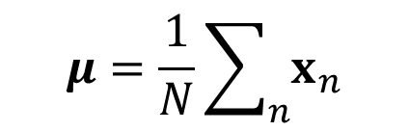
Gaussian distribution (multivariate)
$$p\left(x_{1}, …,x_{D}\right)=$$
$$𝒩\left(x;μ,Σ\right)=\frac{1}{\sqrt{{\left(2π\right)}^{D}|Σ|}}e^{−\frac{1}{2}{\left(x−μ\right)}^{T}Σ^{−1}\left(x−μ\right)}$$
ML estimates of parameters
$$μ=\frac{1}{N}\sum_{n}{x_{n}}$$
$$Σ=\frac{1}{N}\sum_{n}{{\left(x_{n}−μ\right)\left(x_{n}−μ\right)}^{T}}$$

Slide 17
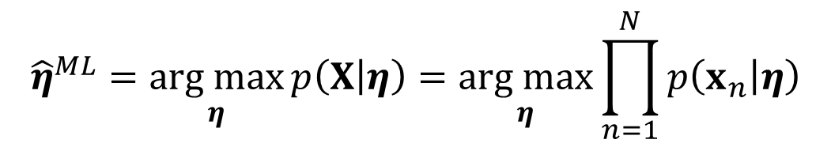
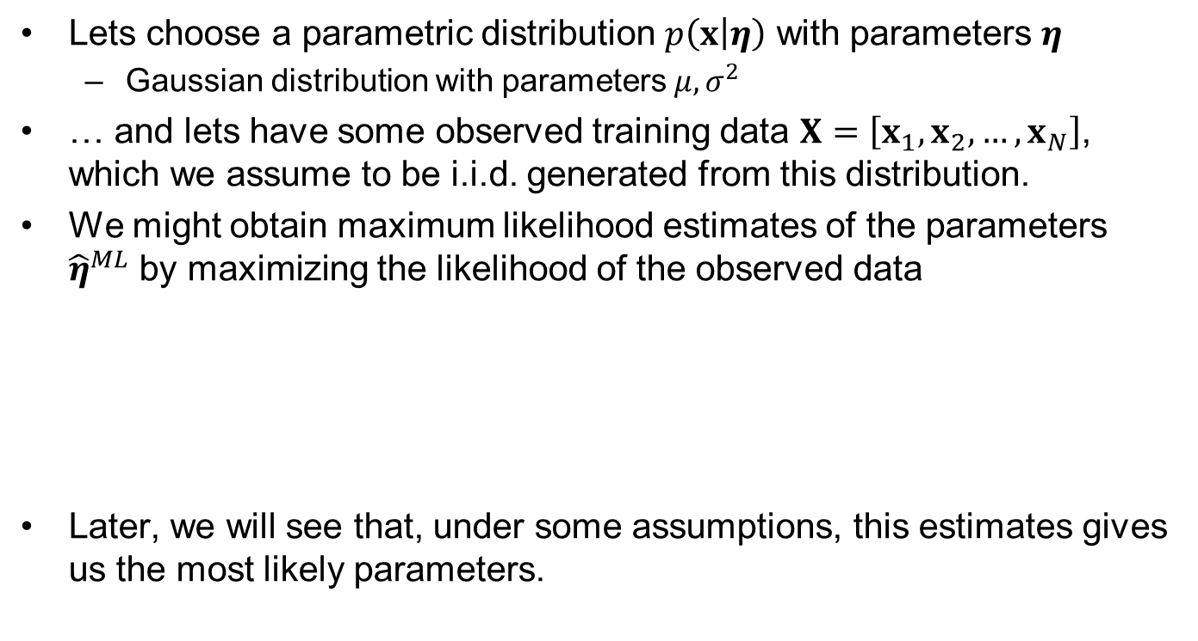
Maximum likelihood estimation of parameters
Lets choose a parametric distribution $p\left(x | η\right)$ with parameters $η$
  Gaussian distribution with parameters $μ,σ^{2}$
… and lets have some observed training data $X=\left[x_{1},x_{2},…,x_{N}\right]$, which we assume to be i.i.d. generated from this distribution.
We might obtain maximum likelihood estimates of the parameters ${\hat{η}}^{ML}$ by maximizing the likelihood of the observed data
Later, we will see that, under some assumptions, this estimates gives us the most likely parameters.
$${\hat{η}}^{ML}=\underset{η}{arg max}{p\left(X | η\right)}=\underset{η}{arg max}{\prod_{n=1}^{N}{p\left(x_{n} | η\right)}}$$

Slide 18
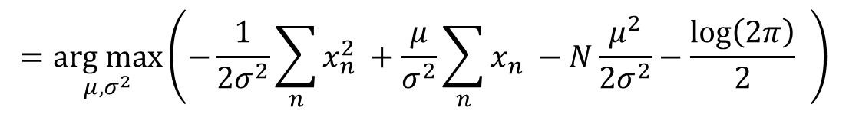
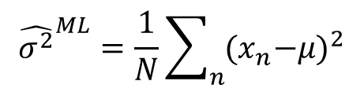
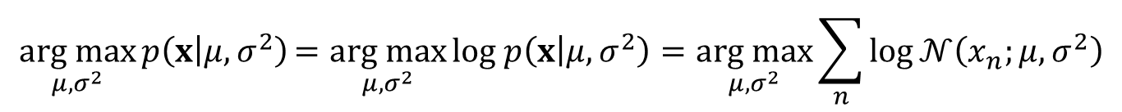
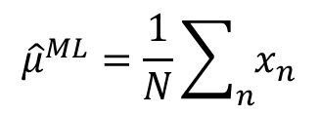
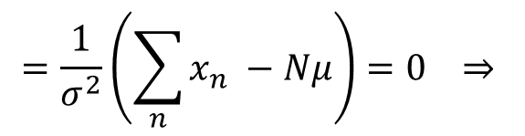
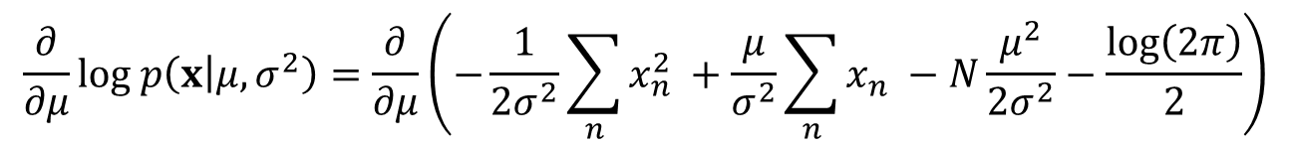
ML estimate for Gaussian
$$\underset{μ,σ^{2}}{arg max}{p\left(x | μ,σ^{2}\right)}=\underset{μ,σ^{2}}{arg max}{log p\left(x | μ,σ^{2}\right)}=\underset{μ,σ^{2}}{arg max}\sum_{n}{log}𝒩\left(x_{n};μ,σ^{2}\right)$$
$$=\underset{μ,σ^{2}}{arg max}\left(−\frac{1}{2σ^{2}}\sum_{n}{x_{n}^{2} }+\frac{μ}{σ^{2}}\sum_{n}{x_{n} }−N\frac{μ^{2}}{2σ^{2}}−\frac{log\left(2π\right)}{2} \right)$$
$$\frac{∂}{∂μ}log p\left(x | μ,σ^{2}\right)=\frac{∂}{∂μ}\left(−\frac{1}{2σ^{2}}\sum_{n}{x_{n}^{2} }+\frac{μ}{σ^{2}}\sum_{n}{x_{n} }−N\frac{μ^{2}}{2σ^{2}}−\frac{log\left(2π\right)}{2}\right)$$
$$=\frac{1}{σ^{2}}\left(\sum_{n}{x_{n} }−Nμ\right)=0 ⇒$$
$${\hat{μ}}^{ML}=\frac{1}{N}\sum_{n}{x_{n}}$$
$${\hat{σ^{2}}}^{ML}=\frac{1}{N}\sum_{n}{{{(x}_{n}−μ)}^{2}}$$
and similarly:

Slide 19
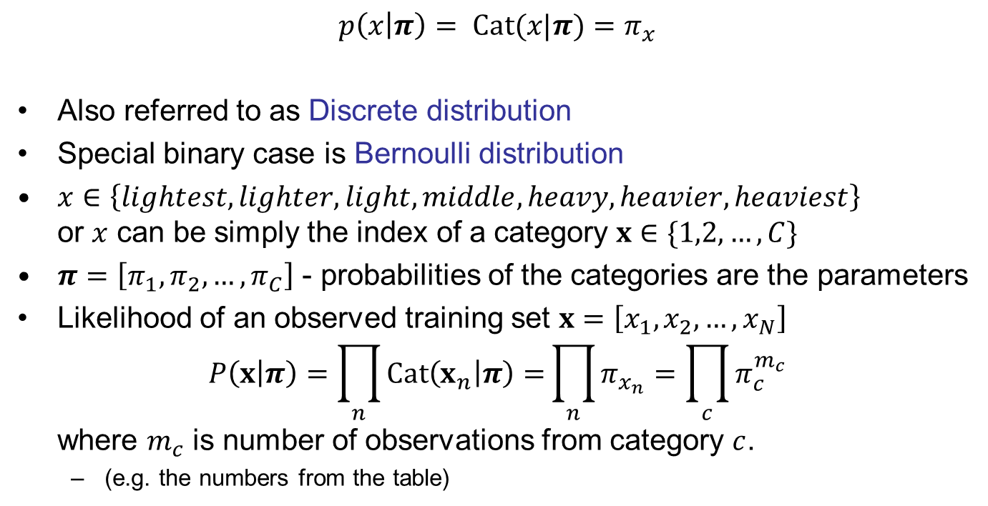
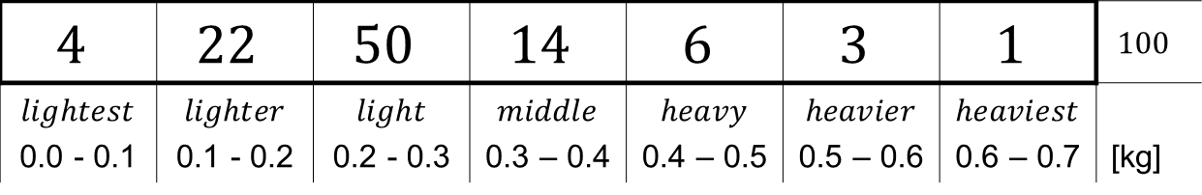
Categorical distribution
$$4$$ | $$22$$ | $$50$$ | $$14$$ | $$6$$ | $$3$$ | $$1$$ | $$100$$
$$lightest$$ 0.0 - 0.1 | $$lighter$$ 0.1 - 0.2 | $$light$$ 0.2 - 0.3 | $$middle$$ 0.3 – 0.4 | $$heavy$$ 0.4 – 0.5 | $$heavier$$ 0.5 – 0.6 | $$heaviest$$ 0.6 – 0.7 | [kg]
$$p\left(x | π\right)= Cat(x|π)=π_{x}$$
Also referred to as Discrete distribution
Special binary case is Bernoulli distribution
$x∈\left\{lightest, lighter, light, middle, heavy, heavier, heaviest\right\}$
or $x$ can be simply the index of a category $x∈\{1,2,…, C\}$
$π=\left[π_{1}, π_{2},…,π_{C}\right]$ - probabilities of the categories are the parameters
Likelihood of an observed training set $x=\left[x_{1}, x_{2},…,x_{N}\right]$
$P\left(x | π\right)=\prod_{n}{Cat\left(x_{n} | π\right)=}\prod_{n}{π_{x_{n}}}=\prod_{c}{π_{c}^{m_{c}}}$
where $m_{c}$ is number of observations from category $c$.
  (e.g. the numbers from the table)

Slide 20
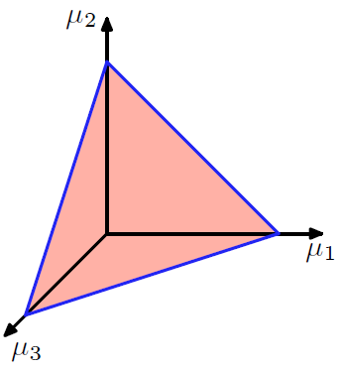

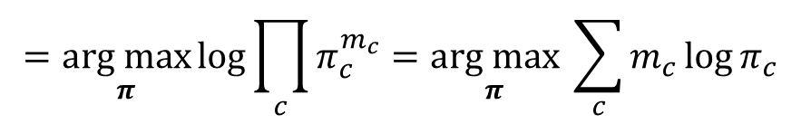

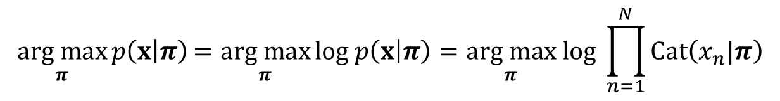
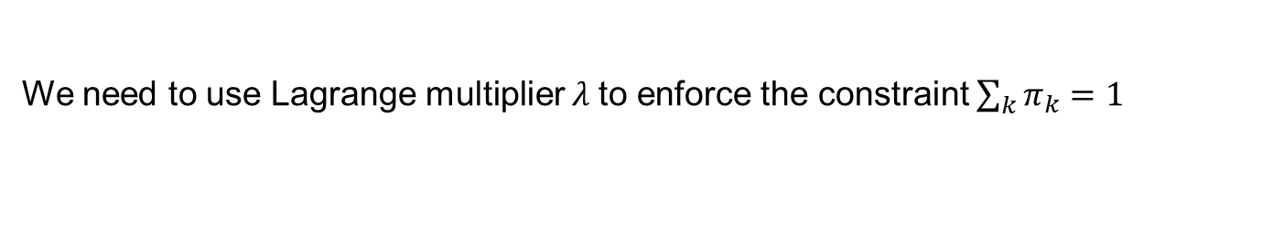
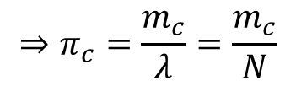

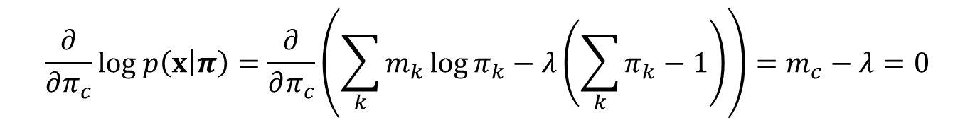

ML estimate for Categorical
$$\underset{π}{arg max}{p\left(x | π\right)}=\underset{π}{arg max}{log p\left(x | π\right)}=\underset{π}{arg max} log \prod_{n=1}^{N}{Cat\left(x_{n}|π\right)}$$
$$=\underset{π}{arg max}\log{\prod_{c}{π_{c}^{m_{c}}}}=\underset{π}{arg max} \sum_{c}{m_{c}\log{π_{c}}}$$
We need to use Lagrange multiplier $λ$to enforce the constraint $\sum_{k}{π_{k}}=1$
$$\frac{∂}{∂π_{c}}log p\left(x | π\right)=\frac{∂}{∂π_{c}}\left(\sum_{k}{m_{k}\log{π_{k}}}−λ\left(\sum_{k}{π_{k}−1}\right)\right)=m_{c}−λ=0$$
$$π_{2}$$
$$⇒π_{c}=\frac{m_{c}}{λ}=\frac{m_{c}}{N}$$
$$C=3$$
$$π_{1}$$
$$π_{3}$$

