Slide 1

Bayesian Models in Machine Learning
Lukáš Burget
Escuela de Ciencias Informáticas 2017
Buenos Aires, July 24-29 2017

Slide 2
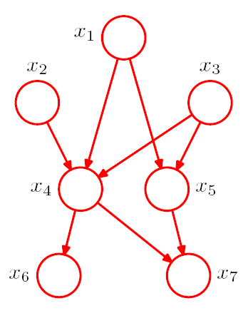
Bayesian Networks
The graph corresponds to a particular factorization of a joint probability distribution over a set of random variables
Nodes are random variables, but the graph does not say what are the distributions of the variables
The graph represents a set of distributions that conform to the factorization
It is recipe for building more complex models out of simpler probability distributions
Describes the generative process
Generally no closed form solutions for inferences in such models

Slide 3
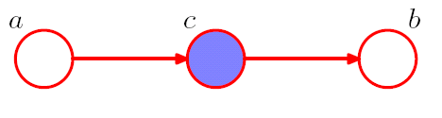


Conditional independence
Bayesian Networks allow us to see conditional independence properties.
Blue nodes corresponds to observed random variables and empty nodes to latent (or hidden) random variables
But the opposite is true for:

Slide 4
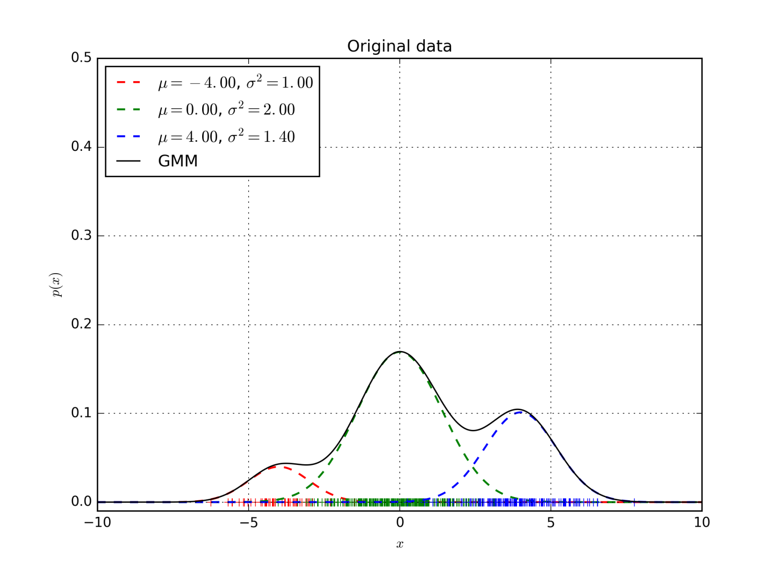

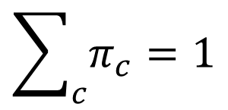

Gaussian Mixture Model (GMM)
$$p\left(x|η\right)=\sum_{c}{𝒩\left(x;μ_{c},σ_{c}^{2} \right)π_{c}}$$
→ p(x)
where
$$η=\{π_{c},μ_{c},σ_{c}^{2}\}$$
$$\sum_{c}{π_{c}}=1$$
→ x
We can see the sum above just as a function defining the shape of the probability density function
or …

Slide 5


Multivariate GMM
$$p\left(x|η\right)=\sum_{c}{𝒩\left(x;μ_{c},Σ_{c}\right)π_{c}}$$
where
$$η=\{π_{c},μ_{c},Σ_{c}\}$$
$$\sum_{c}{π_{c}}=1$$
We can see the sum above just as a function defining the shape of the probability density function
or …

Slide 6
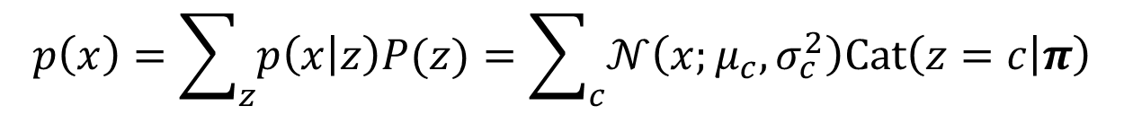
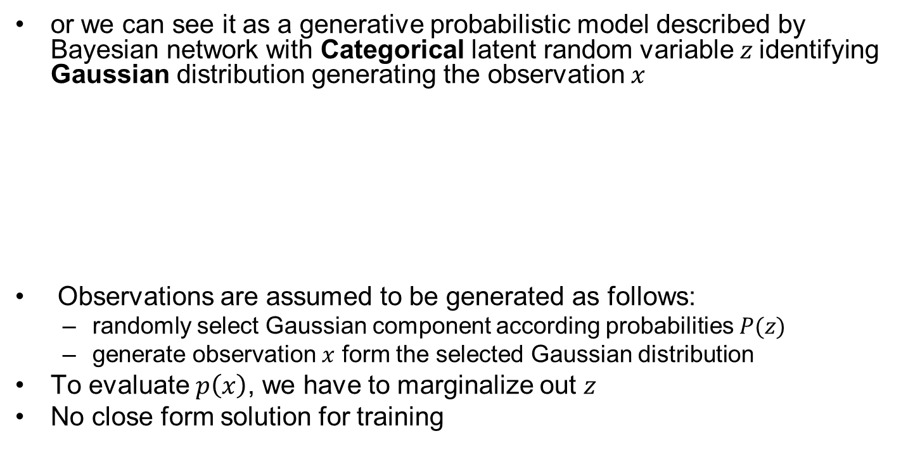



Gaussian Mixture Model
$$p\left(x\right)=\sum_{z}{p\left(x | z\right)P(z)}=\sum_{c}{𝒩\left(x;μ_{c},σ_{c}^{2}\right)Cat\left(z=c | π\right)}$$
or we can see it as a generative probabilistic model described by Bayesian network with Categorical latent random variable $z$identifying Gaussian distribution generating the observation $x$
Observations are assumed to be generated as follows:
  randomly select Gaussian component according probabilities $P(z)$
  generate observation $x$ form the selected Gaussian distribution
To evaluate $p\left(x\right)$, we have to marginalize out $z$
No close form solution for training
$$z$$
$$p\left(x,z\right)=p\left(x | z\right)P(z)$$
$$x$$

Slide 7

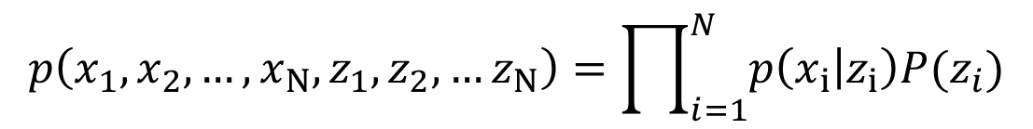
Bayesian Networks for GMM
Multiple observations:
z₁
z₂
z_{N-1}
z_{N}
z_{i}
or
x₁
x₂
x_{N-1}
x_{N}
x_{i}
$$i=1..N$$
$$p\left(x_{1},x_{2},…,x_{N},z_{1},z_{2},…z_{N}\right)=\prod_{i=1}^{N}{p\left(x_{i} | z_{i}\right)P(z_{i})}$$

Slide 8
Training GMM –Viterbi training
Intuitive and Approximate iterative algorithm for training GMM parameters.
Using current model parameters, let Gaussians classify data as if the Gaussians were different classes (Even though all the data corresponds to only one class modeled by the GMM)
Re-estimate parameters of Gaussians using the data assigned to them in the previous step.
New weights will be proportional to the number of data points assigned to the Gaussians.
Repeat the previous two steps until the algorithm converges.

Slide 9
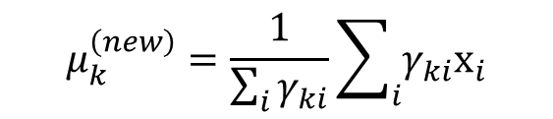
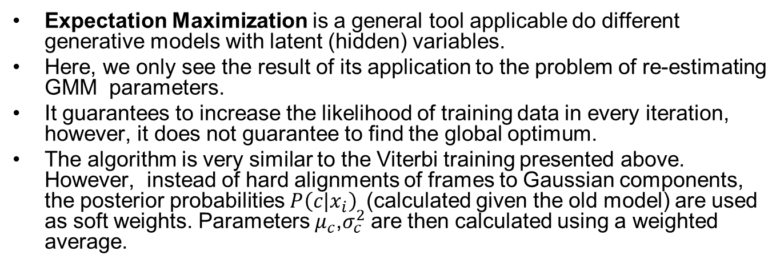
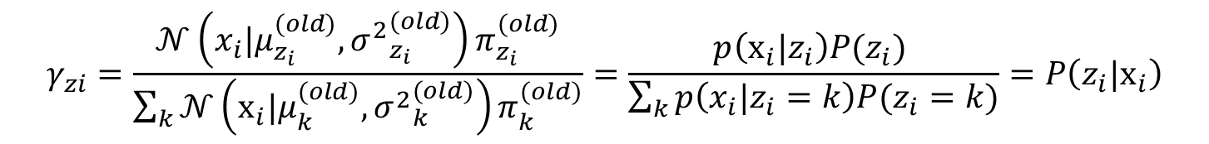
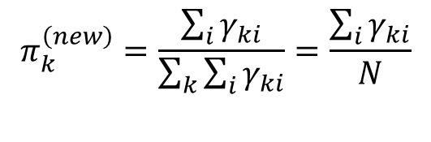

Training GMM – EM algorithm
Expectation Maximization is a general tool applicable do different generative models with latent (hidden) variables.
Here, we only see the result of its application to the problem of re-estimating GMM parameters.
It guarantees to increase the likelihood of training data in every iteration, however, it does not guarantee to find the global optimum.
The algorithm is very similar to the Viterbi training presented above. However, instead of hard alignments of frames to Gaussian components, the posterior probabilities $P\left(c|x_{i}\right)$(calculated given the old model) are used as soft weights. Parameters $μ_{c}^{}$,$σ_{c}^{2}$are then calculated using a weighted average.
$$γ_{zi}=\frac{𝒩\left(x_{i}|μ_{z_{i}}^{(old)},{σ^{2}}_{z_{i}}^{(old)}\right)π_{z_{i}}^{(old)}}{\sum_{k}{𝒩\left(x_{i}|μ_{k}^{(old)},{σ^{2}}_{k}^{(old)}\right)π_{k}^{(old)}}}=\frac{p\left(x_{i}|z_{i}\right)P(z_{i}) }{\sum_{k}{p\left(x_{i}|z_{i}=k\right)P(z_{i}=k)}}=P\left(z_{i}|x_{i}\right)$$
$$μ_{k}^{\left(new\right)}=\frac{1}{\sum_{i}{γ_{ki}}}\sum_{i}{γ_{ki}x_{i}}$$
$$π_{k}^{\left(new\right)}=\frac{\sum_{i}{γ_{ki}}}{\sum_{k}{\sum_{i}{γ_{ki}}}}=\frac{\sum_{i}{γ_{ki}}}{N}$$
$${σ^{2}}_{z}^{\left(new\right)}=\frac{1}{\sum_{i}{γ_{ki}}}\sum_{i}{γ_{ki}{\left(x_{i}−μ_{k}\right)}^{2}}$$

Slide 10
GMM to be learned

Slide 11
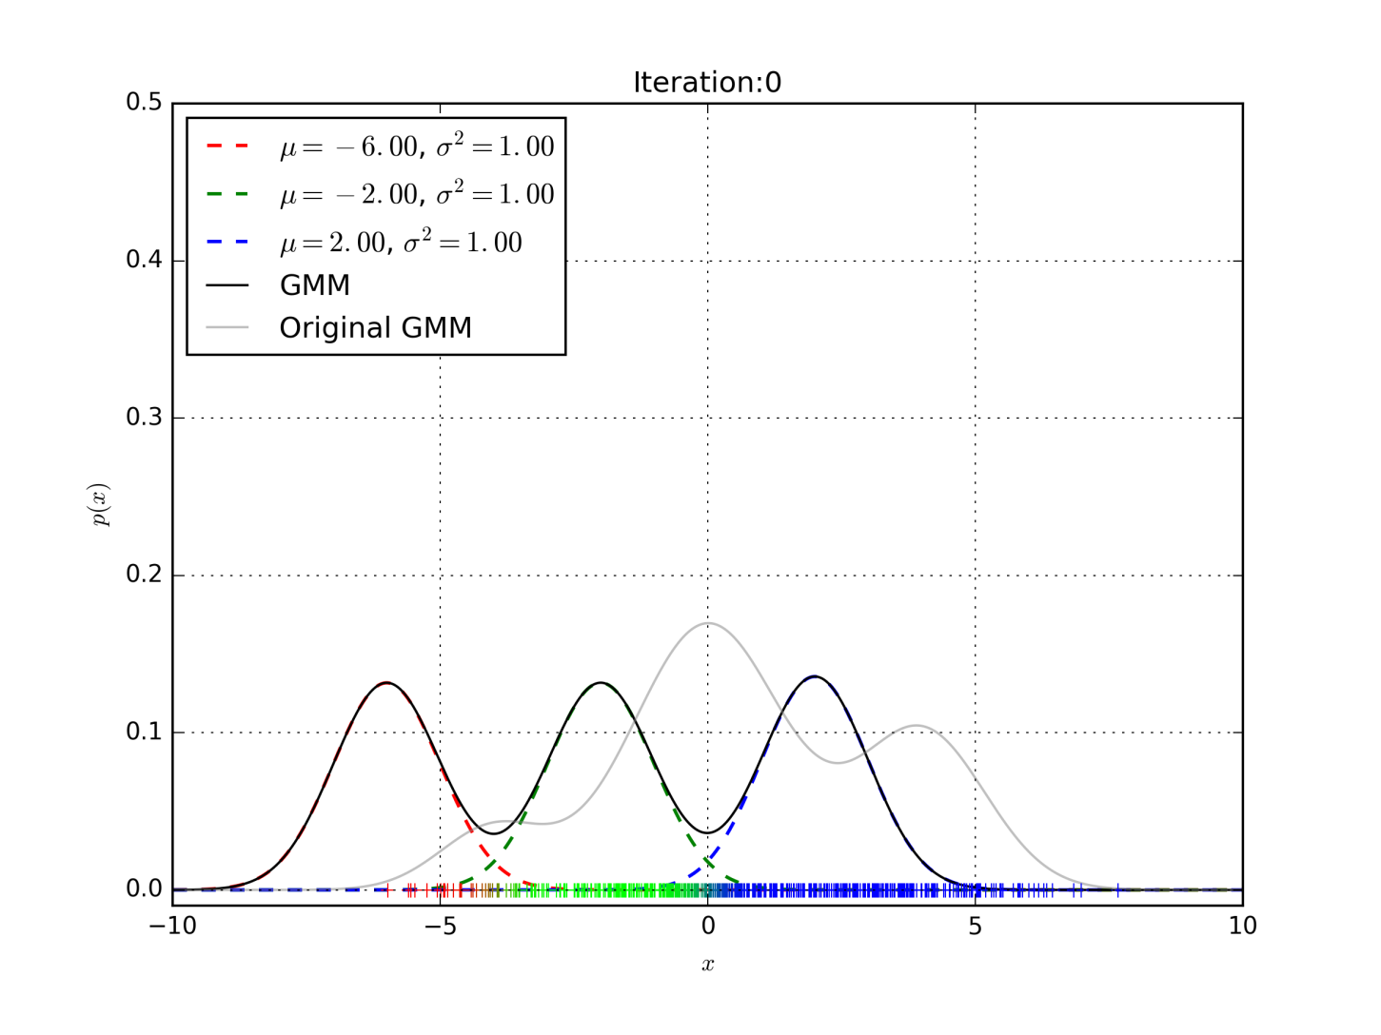
EM algorithm

Slide 12
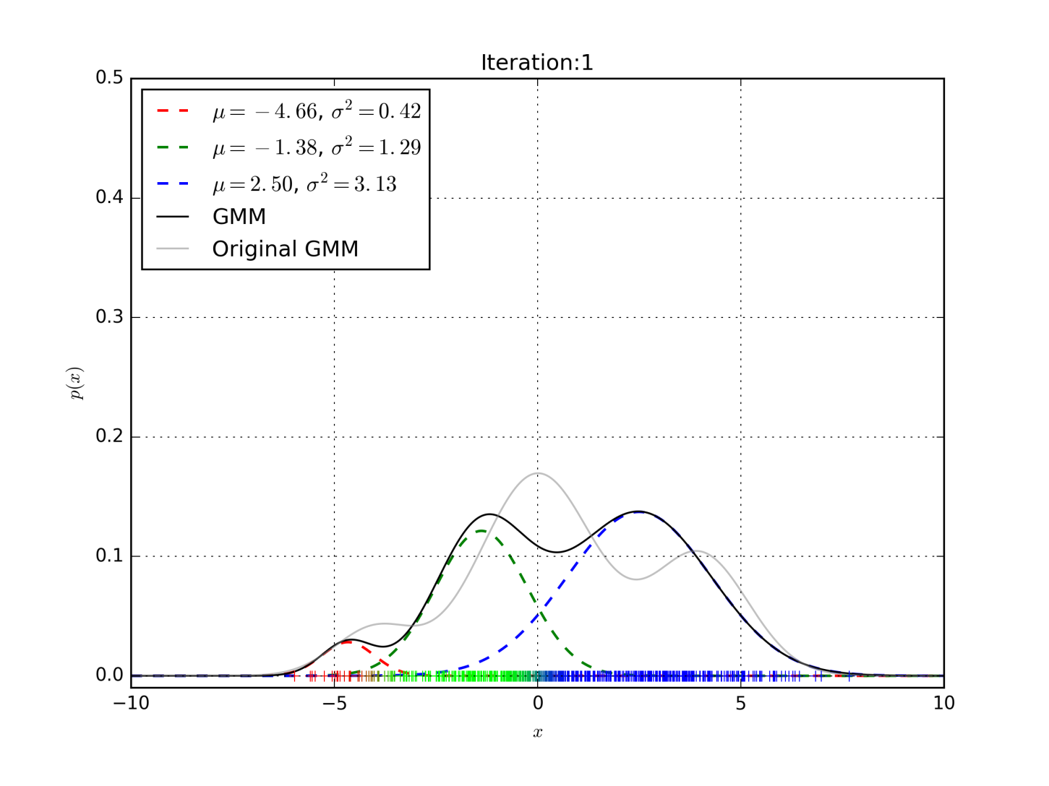
EM algorithm

Slide 13
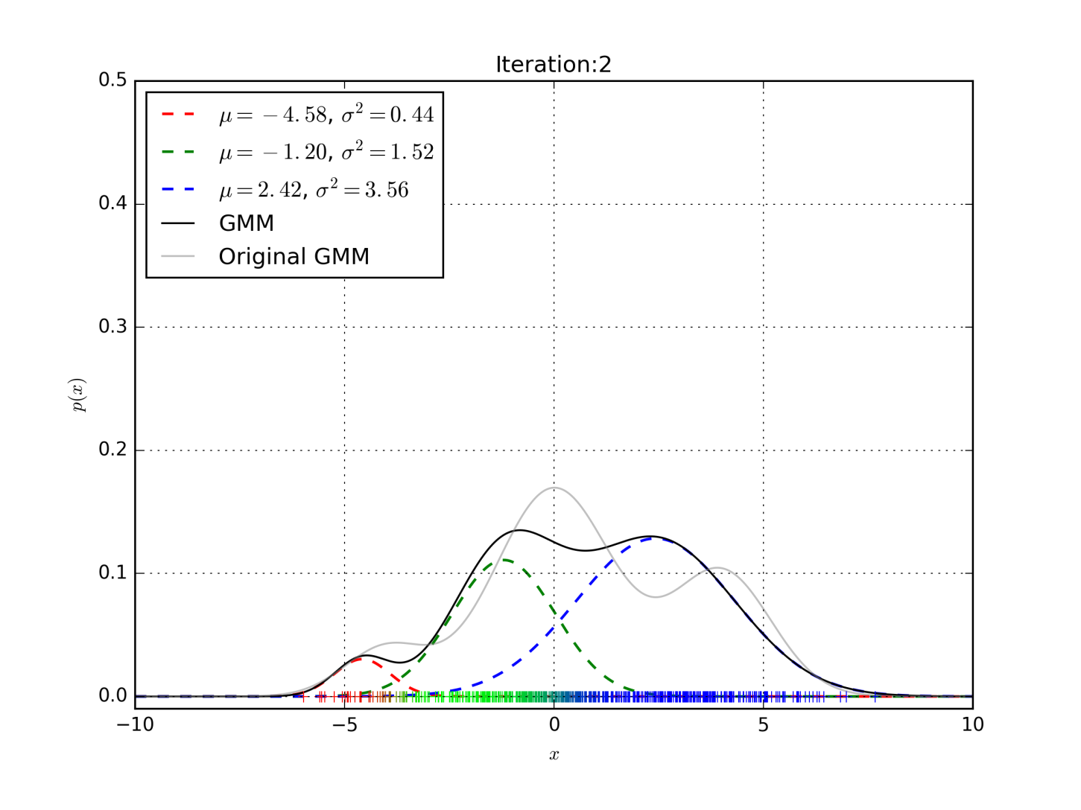
EM algorithm

Slide 14

EM algorithm

Slide 15
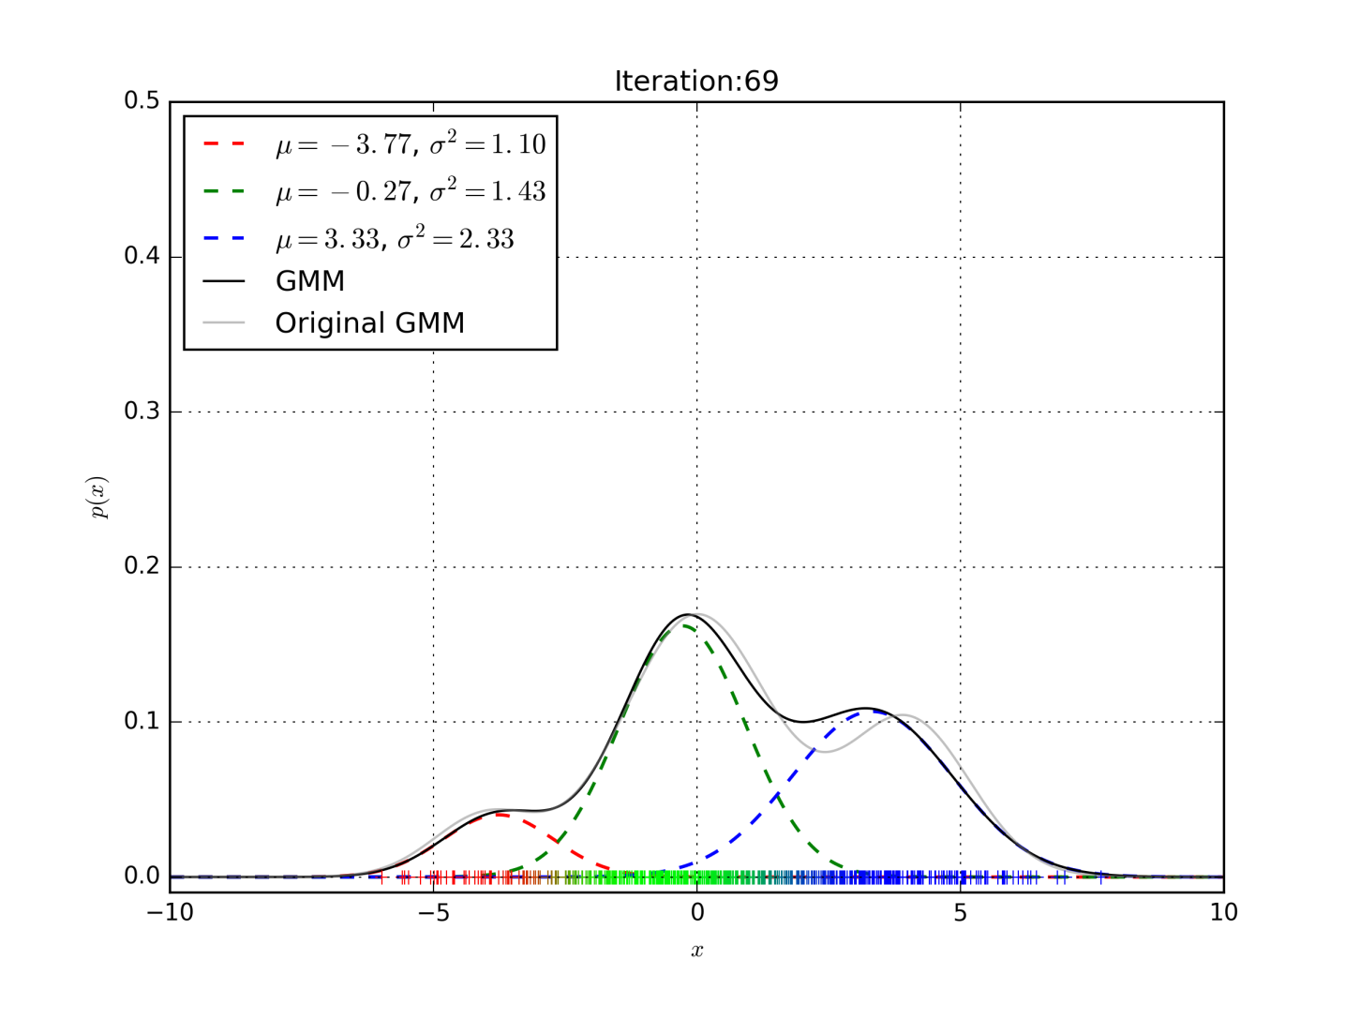
EM algorithm

Slide 16
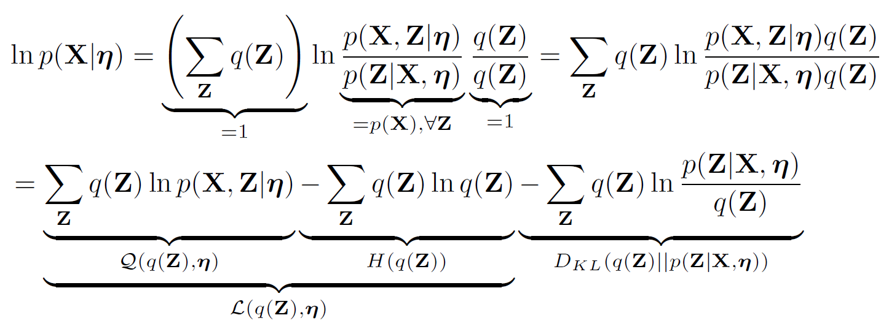
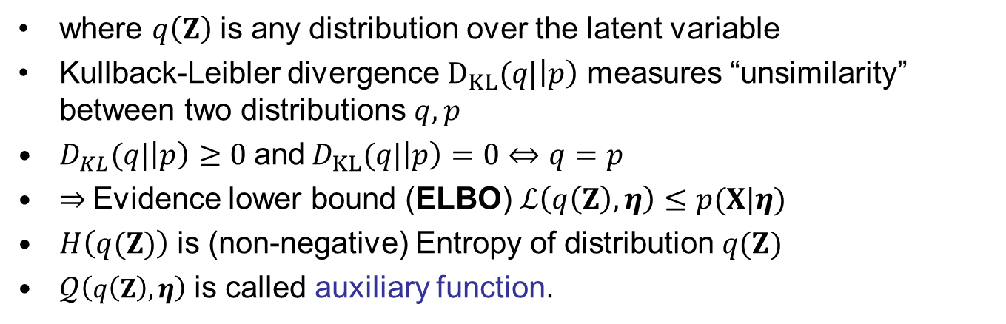
Expectation maximization algorithm
where $q\left(Z\right)$is any distribution over the latent variable
Kullback-Leibler divergence $D_{KL}(q|\left|p\right)$ measures “unsimilarity” between two distributions $q,p$
$D_{KL}(q|\left|p\right)≥0$and$D_{KL}(q|\left|p\right)=0⇔q=p$
⇒ Evidence lower bound (ELBO) $ℒ\left(q\left(Z\right),η\right)≤p(X|η)$
$H\left(q(Z)\right)$ is (non-negative) Entropy of distribution $q(Z)$
$𝒬\left(q\left(Z\right),η\right)$ is called auxiliary function.

Slide 17
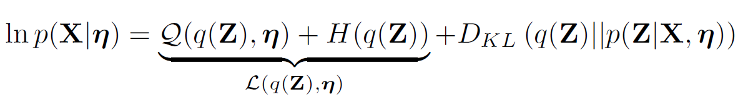
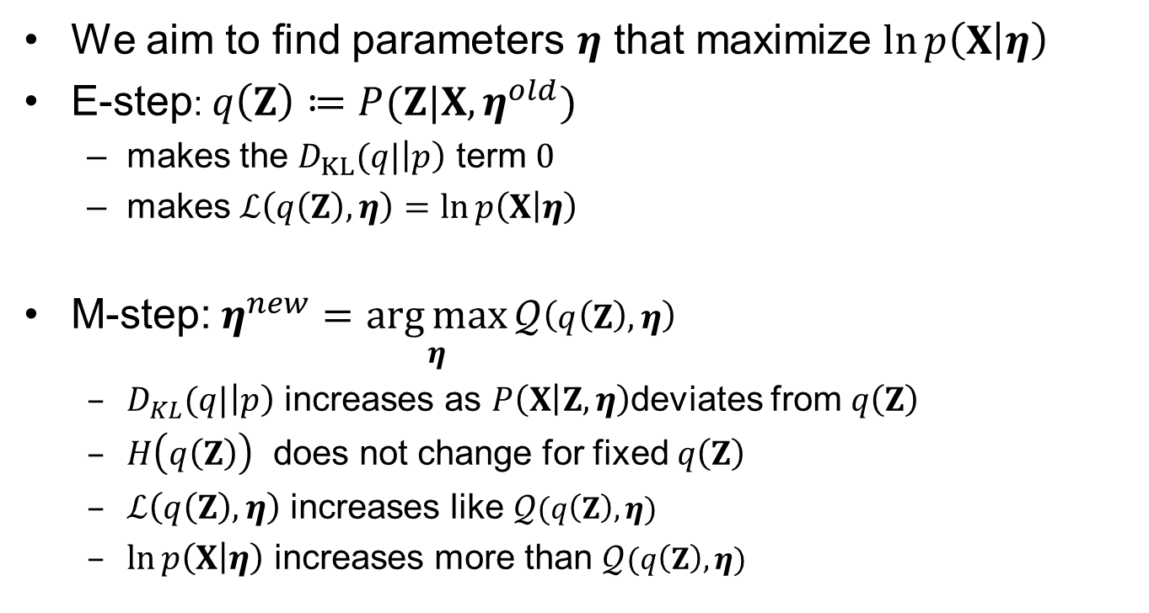
Expectation maximization algorithm
We aim to find parameters $η$ that maximize $\ln{p\left(X | η\right)}$
E-step: $q\left(Z\right)≔P(Z|X,η^{old})$
  makes the $D_{KL}(q|\left|p\right)$ term $0$
  makes $ℒ\left(q\left(Z\right),η\right)=\ln{p\left(X | η\right)}$
M-step:$η^{new}=\underset{η}{\arg{max}}𝒬\left(q\left(Z\right),η\right)$
  $D_{KL}(q|\left|p\right)$ increases as $P\left(X | Z,η\right)$deviates from $q\left(Z\right)$
  $H\left(q\left(Z\right)\right)$ does not change for fixed $q\left(Z\right)$
  $ℒ\left(q\left(Z\right),η\right)$ increases like $𝒬(q\left(Z\right),η)$
  $\ln{p\left(X | η\right)}$ increases more than $𝒬(q\left(Z\right),η)$

Slide 18
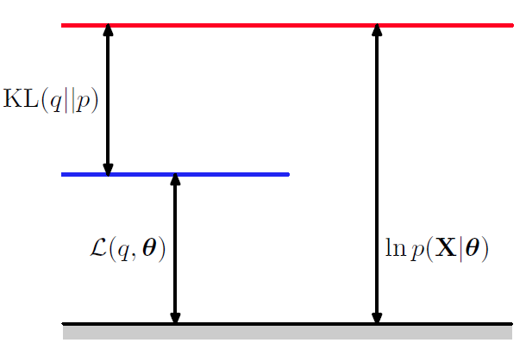
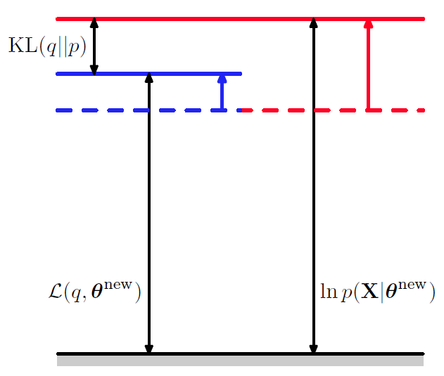
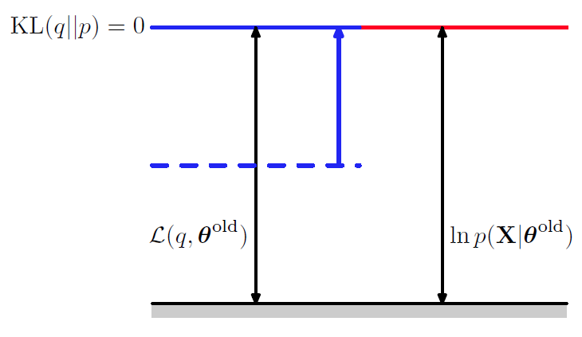
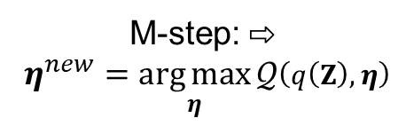

Expectation maximization algorithm
⇩ E-step: $q\left(Z\right)≔P(Z|X,η^{old})$
M-step: ⇨
$η^{new}=\underset{η}{\arg{max}}𝒬\left(q\left(Z\right),η\right)$

Slide 19
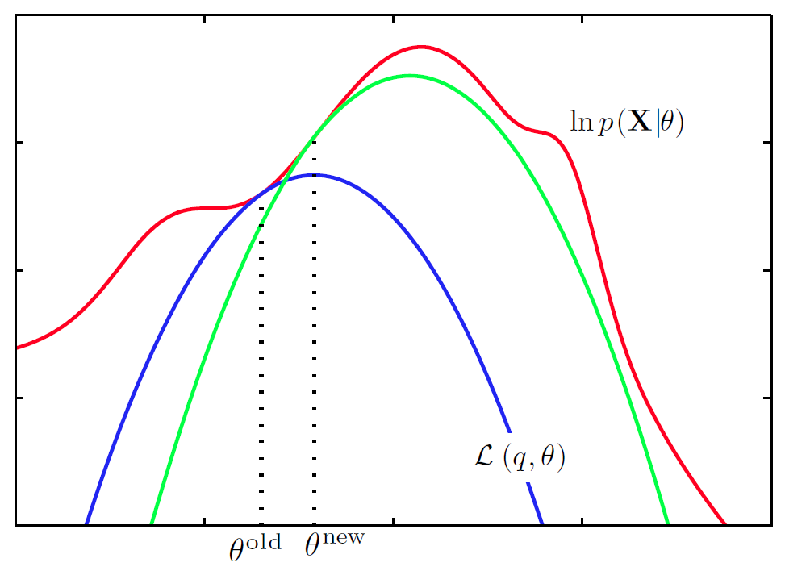
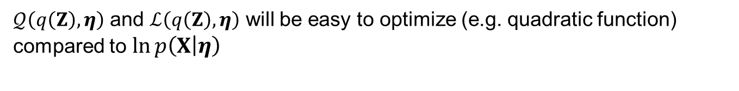

Expectation maximization algorithm
$𝒬\left(q\left(Z\right),η\right)$ and $ℒ\left(q\left(Z\right),η\right)$ will be easy to optimize (e.g. quadratic function) compared to $\ln{p\left(X | η\right)}$
$$η^{old}{ η}^{new}$$

Slide 20

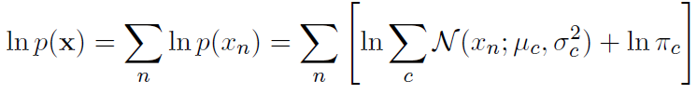




EM for GMM
Now, we aim to train parameters $η=\left\{μ_{z}, σ_{z}^{2}, π_{z}\right\}$ of Gaussian Mixture model
Given training observations $x=[x_{1}, x_{2}, …, x_{N}]$ we search for ML estimate of $η$ that maximizes log likelihood of the training data.
Direct maximization of this objective function w.r.t. $η$ is intractable.
We will use EM algorithm, where we maximize the auxiliary function which is (for simplicity) sum of per-observation auxiliary functions
Again, in M-step has to increase more than

Slide 21
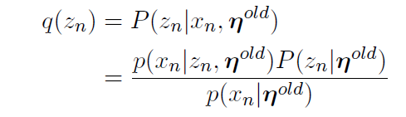
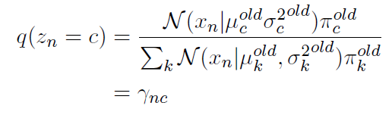
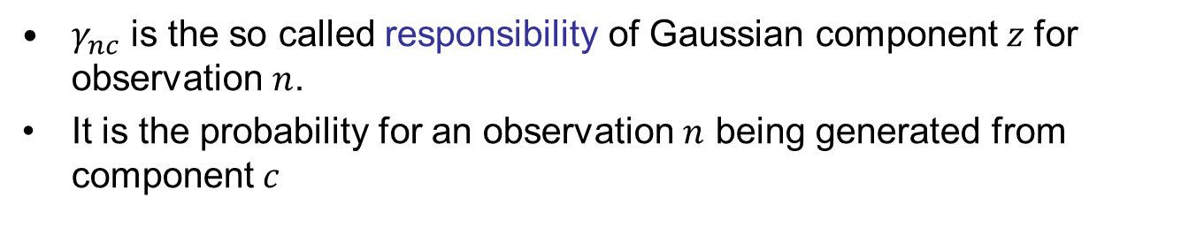
EM for GMM – E-step
$γ_{nc}$ is the so called responsibility of Gaussian component$z$ for observation $n$.
It is the probability for an observation $n$ being generated from component$c$

Slide 22
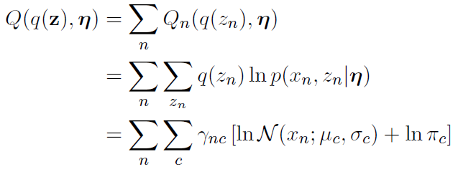
EM for GMM – M-step
In M-step, the auxiliary function is maximized w.r.t. all GMM parameters

Slide 23
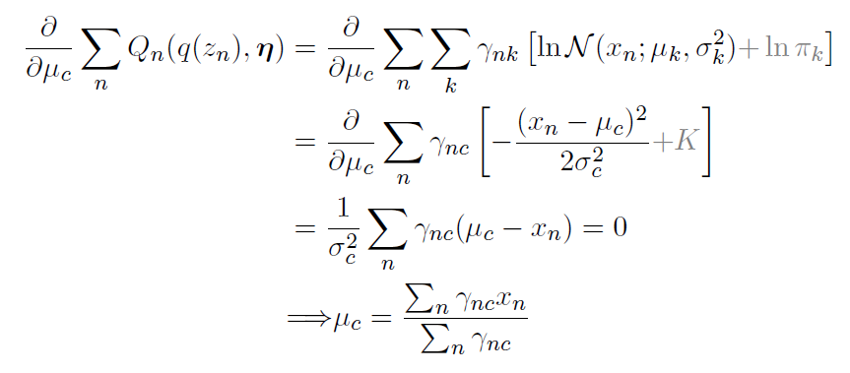
EM for GMM –update of means
Update for component mean means:
Update for variances can be derived similarly.

Slide 24
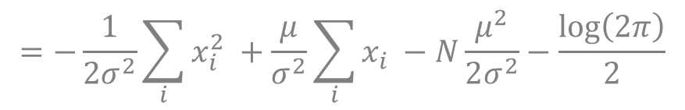
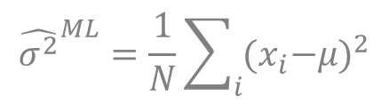
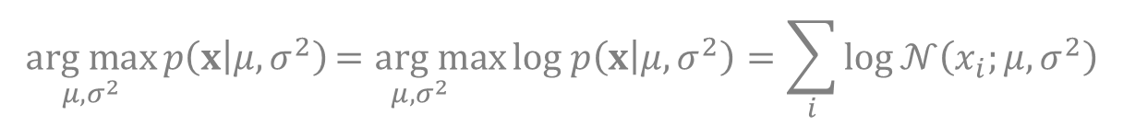
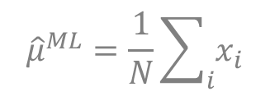
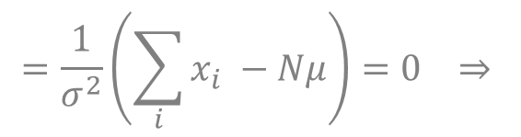
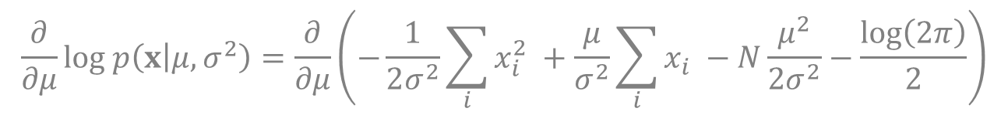
Flashback: ML estimate for Gaussian
$$\underset{μ,σ^{2}}{arg max}{p\left(x | μ,σ^{2}\right)}\underset{μ,σ^{2}}{=arg max}{log p\left(x | μ,σ^{2}\right)}=\sum_{i}{log}𝒩\left(x_{i};μ,σ^{2}\right)$$
$$=−\frac{1}{2σ^{2}}\sum_{i}{x_{i}^{2} }+\frac{μ}{σ^{2}}\sum_{i}{x_{i} }−N\frac{μ^{2}}{2σ^{2}}−\frac{log\left(2π\right)}{2}$$
$$\frac{∂}{∂μ}log p\left(x | μ,σ^{2}\right)=\frac{∂}{∂μ}\left(−\frac{1}{2σ^{2}}\sum_{i}{x_{i}^{2} }+\frac{μ}{σ^{2}}\sum_{i}{x_{i} }−N\frac{μ^{2}}{2σ^{2}}−\frac{log\left(2π\right)}{2}\right)$$
$$=\frac{1}{σ^{2}}\left(\sum_{i}{x_{i} }−Nμ\right)=0 ⇒$$
$${\hat{μ}}^{ML}=\frac{1}{N}\sum_{i}{x_{i}}$$
$${\hat{σ^{2}}}^{ML}=\frac{1}{N}\sum_{i}{{{(x}_{i}−μ)}^{2}}$$
and similarly:

Slide 25
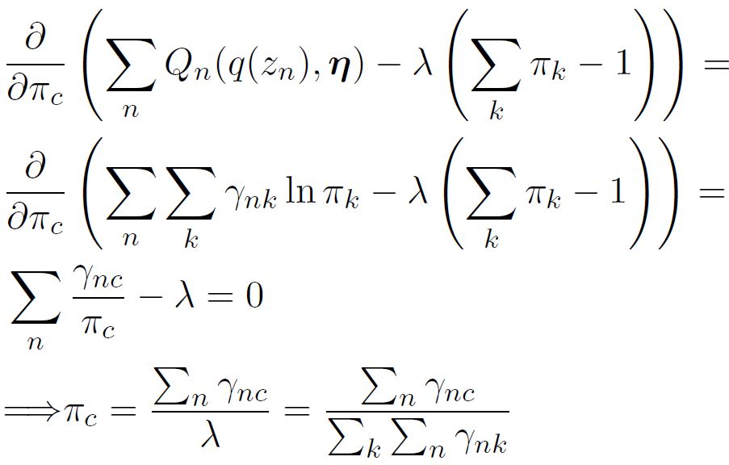

EM for GMM –update of weights
Weights $π_{c}$ need to sum up to one. When updating weights, Lagrange multiplier $λ$is used to enforce this constraint.

Slide 26
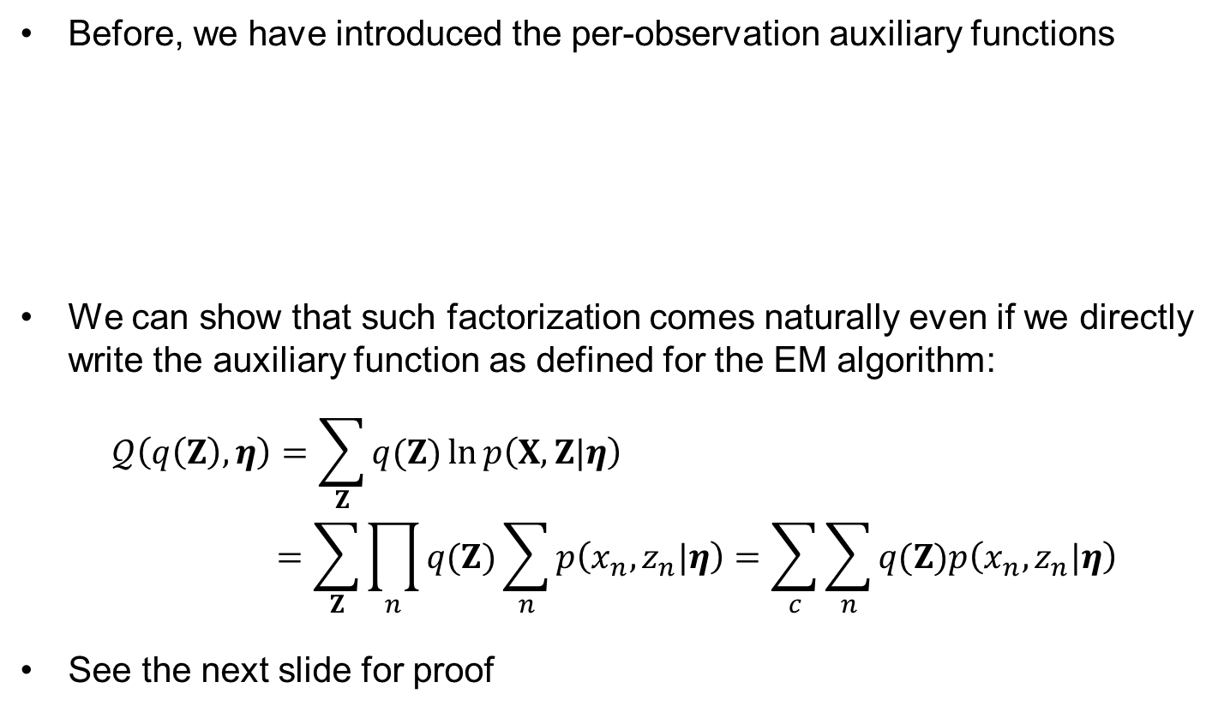
Factorization of the auxiliary function more formally
Before, we have introduced the per-observation auxiliary functions
We can show that such factorization comes naturally even if we directly write the auxiliary function as defined for the EM algorithm:
$$𝒬\left(q\left(Z\right),η\right)=\sum_{Z}{q(Z)}\ln{p\left(X,Z|η\right)} \\ =\sum_{Z}{\prod_{n}{q(Z)}\sum_{n}{p\left(x_{n},z_{n}|η\right)}}=\sum_{c}{\sum_{n}{q(Z)p\left(x_{n},z_{n}|η\right)}}$$
See the next slide for proof

Slide 27
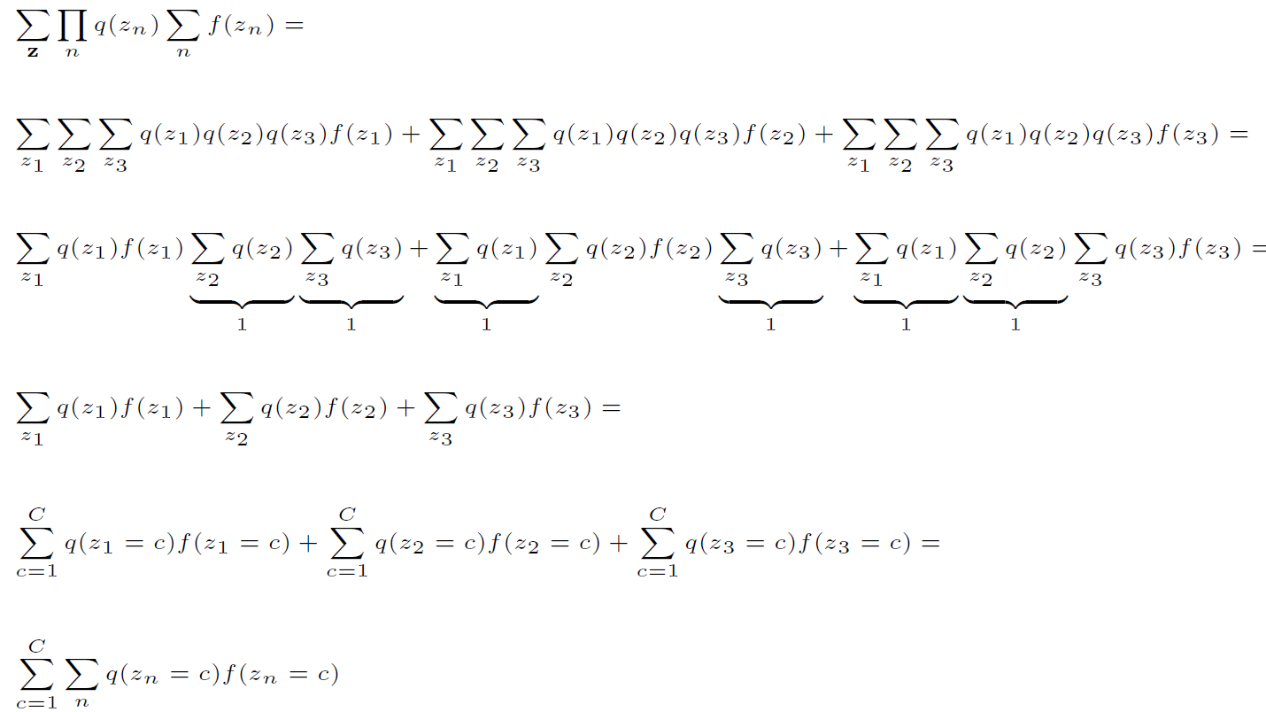
Factorization over components
Example with only 3 fames (i.e $z=[z_{1},z_{2},z_{3}]$)

Slide 28
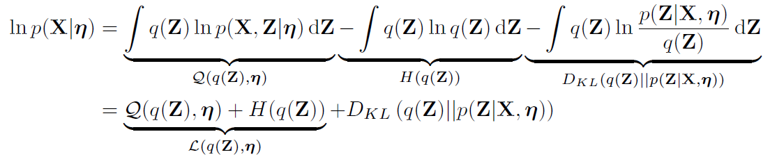
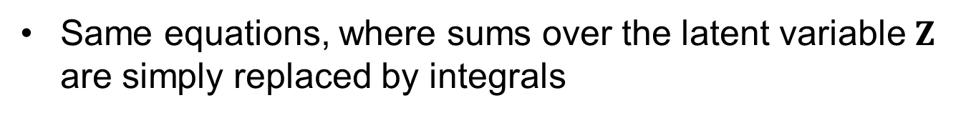
EM for continuous latent variable
Same equations, where sums over the latent variable $Z$ are simply replaced by integrals

Slide 29
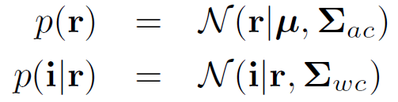
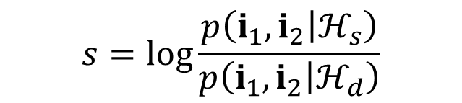


PLDA model for speaker verification
distribution of speaker means
within class (channel) variability
Same speaker hypothesis likelihood:
Different speaker hyp. Likelihood:
Verification score based on Bayesian model comparison:
$$p\left(i_{1},i_{2} | ℋ_{s}\right)=∫p\left(i_{1} | r\right)p\left(i_{2} | r\right)p\left(r\right)\text{d}r$$
$$p\left(i_{1},i_{2} | ℋ_{d}\right)=p\left(i_{1}\right)p\left(i_{2}\right)$$
$$p\left(i\right)=∫p\left(i | r\right)p\left(r\right)\text{d}r$$
$$s=\log{\frac{p\left(i_{1},i_{2} | ℋ_{s}\right)}{p\left(i_{1},i_{2} | ℋ_{d}\right)}}$$

